Slide 1




Amazon Sales
Analysis
Using PowerBi
by Neelima Rani

Slide 2


Objective: Derive actionable insights to support business decision-making and strategy development
Overview of the analysis

Slide 3
Key Objectives
01
03
Identify patterns and trends in order data
Analyze sales performance across different cities
02
04
Provide actionable insights for business improvement
Examine user activity and growth trends

Slide 4

Sales Performance
Total Sales: ,₹ 987 increase
Top Performing Cities: Cities Triupathi ,Bengaluru,Pune

Slide 5

User Activity
Active Users are 78K
Gain Users :12k
Loss Users:38k
City Performance
wise Analysis: Growth in cities Lingampali, Madhapur Hyderabad
Sales Trends: Peak in year 2019 (414M% of total sales)

Slide 6


When do you need this guide?

Slide 7
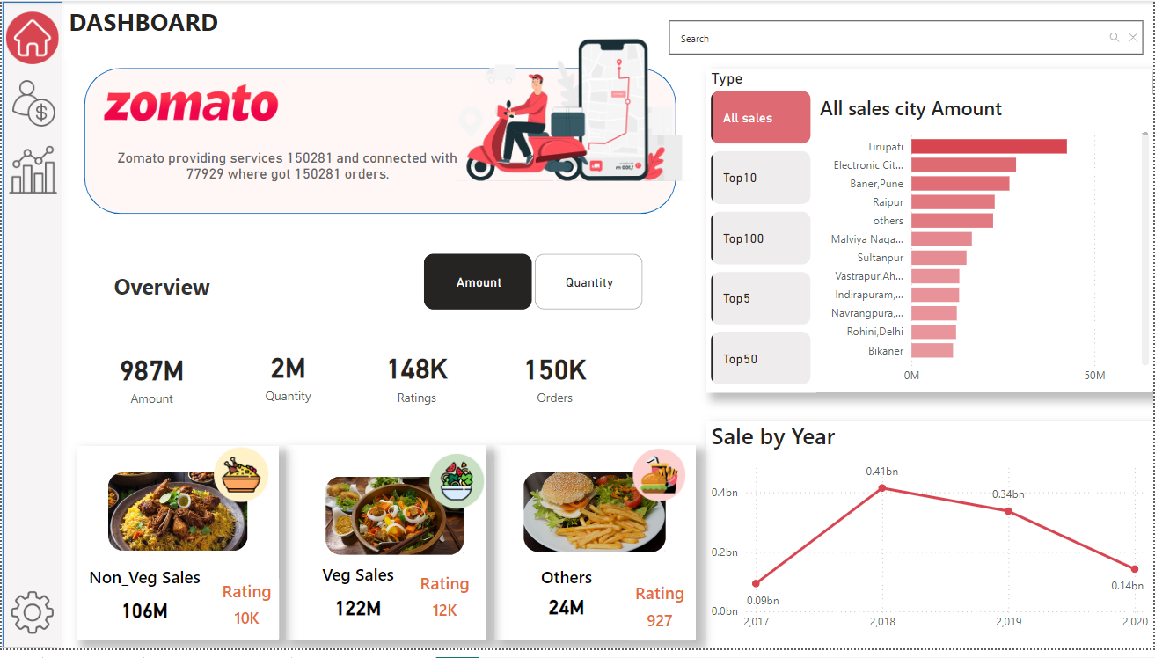


Slide 8
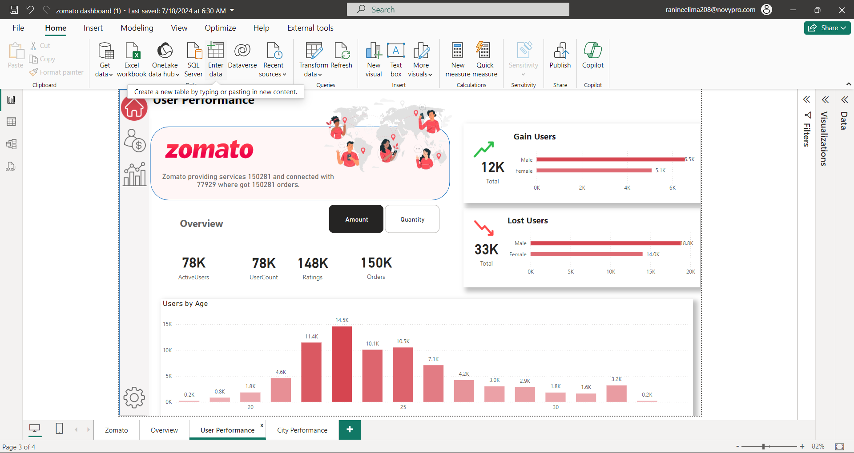

Slide 9
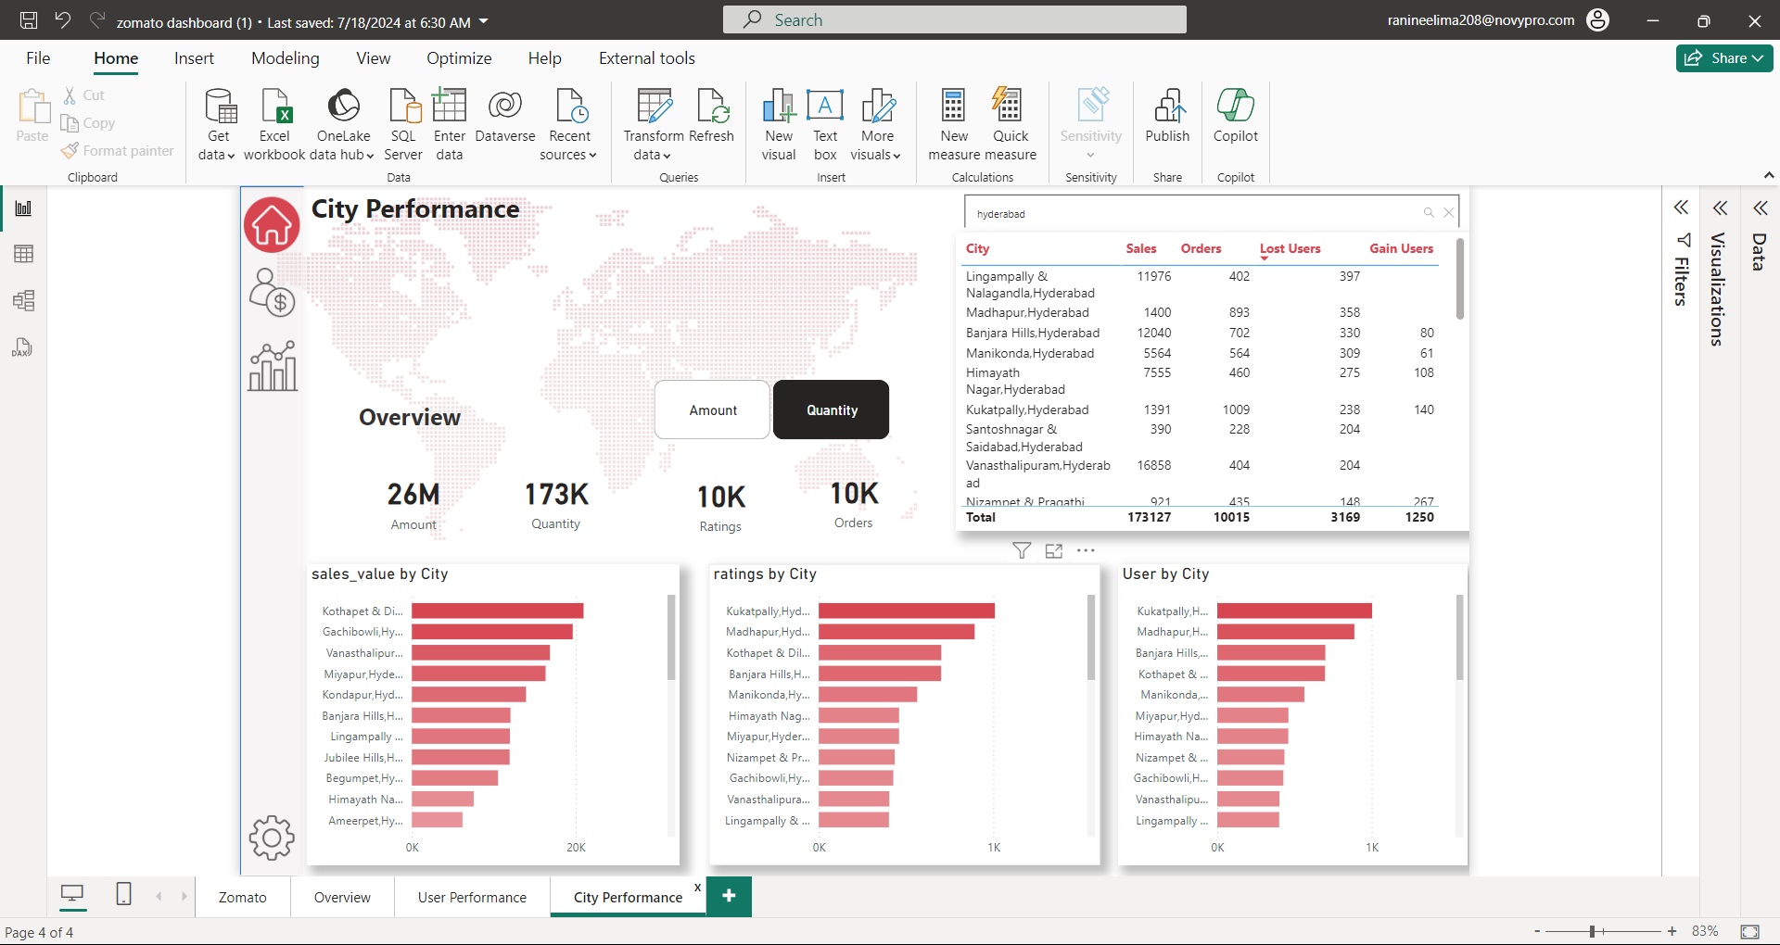

Slide 10
Thank You

